Slide 1



SEED GERMINATION PREDICTOR USING MACHINE LEARNING
Presented By,
BALAJI P (811722104021)
DHINESH KUMAR S (811722104033)
HARIVARMA M (811722104050)
Guided By,
Mrs. R.JASMINE M.E
Assistant Professor,CSE
DD/MM/YYYY

Slide 2

ABSTRACT
1.Seed germination prediction is vital for optimizing agricultural productivity.
Traditional manual methods are inefficient and subjective.
2.This paper proposes a Convolutional Neural Network (CNN)-based model to automate germination prediction using image data.
3.Our CNN architecture processes seed images and classifies them into "germinated" or "non-germinated" seed
4.This model is used to learn about the seeds are of premium quality,standard quality or regular quality.
DD/MM/YYYY

Slide 3
OBJECTIVE
1. To collect a dataset of crop seed images representing bad seed and mature
seed.
2. To implement and evaluate several machine learning models for crop seed
detection, including Convolutional Neural Networks (CNNs) and transfer
learning-based approaches.
3 To compare the performance of the different models and identify the best
performing model for seed analysis.
4. To visualize and interpret the model predictions to gain insights into the
features and patterns that distinguish bad seed and mature seed.
DD/MM/YYYY

Slide 4
LITERATURE SURVEY
S.No. | Paper Title | Year | Remark
1 | Seed Classification Using Convolutional Neural Networks | 2018 | Used CNN to classify seed types based on image features with good accuracy.
2 | Machine Learning Techniques for Seed Germination Prediction | 2019 | Explored SVM, Decision Trees, and Random Forests for germination prediction.
3 | Deep Learning-Based Agricultural Crop and Seed Image Classification | 2020 | Implemented deep CNN for automatic classification of seed and crop types.
DD/MM/YYYY

Slide 5
LITERATURE SURVEY
S.No. | Paper Title | Year | Remark
4 | Image-Based Seed Quality Assessment Using AI | 2021 | Used image analysis to predict seed viability and health using AI algorithms.
5 | An Automated Framework for Seed Health Detection Using Machine Vision | 2021 | Focused on health prediction using features like color, shape, and texture.
6 | Prediction of Crop Growth Factors Based on Seed Type Using Neural Networks | 2022 | Mapped seed types to ideal environmental growth conditions using neural models.
DD/MM/YYYY

Slide 6
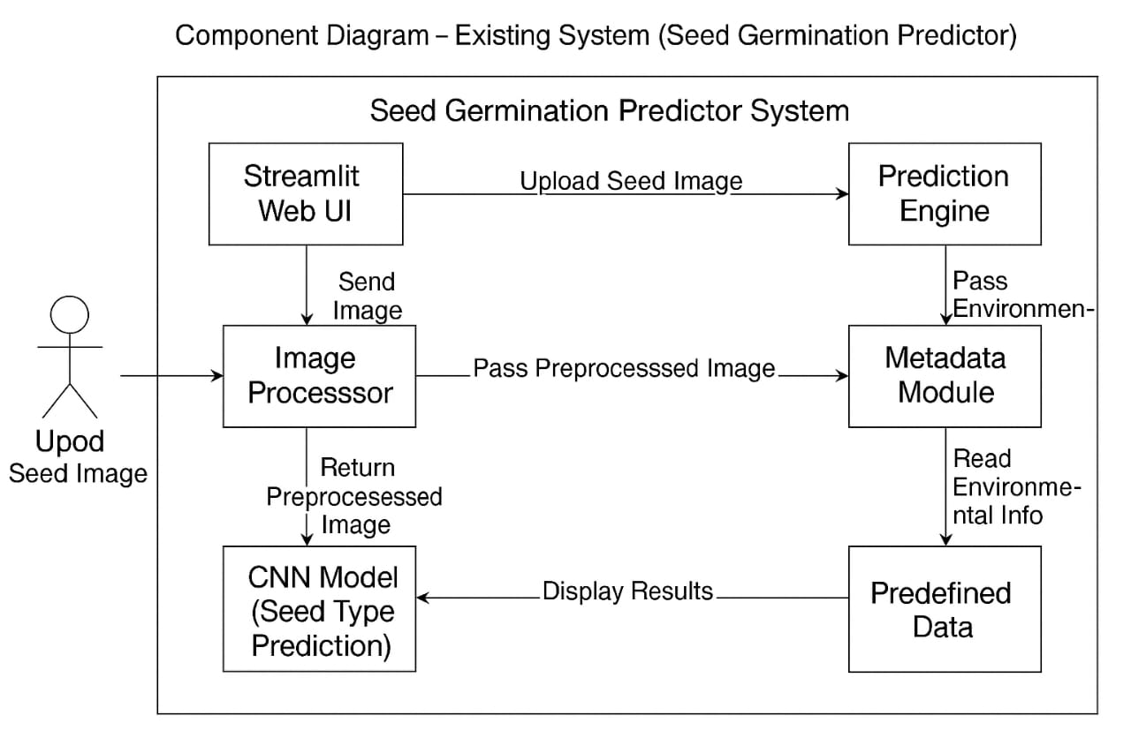
EXISTING SYSTEM
DD/MM/YYYY

Slide 7
PROPOSED SYSTEM
Training and process
dataset
Feature extration
Build the classifier
dataset
Testing dataset
Predictive analysis and result
Train the classifier
DD/MM/YYYY

Slide 8
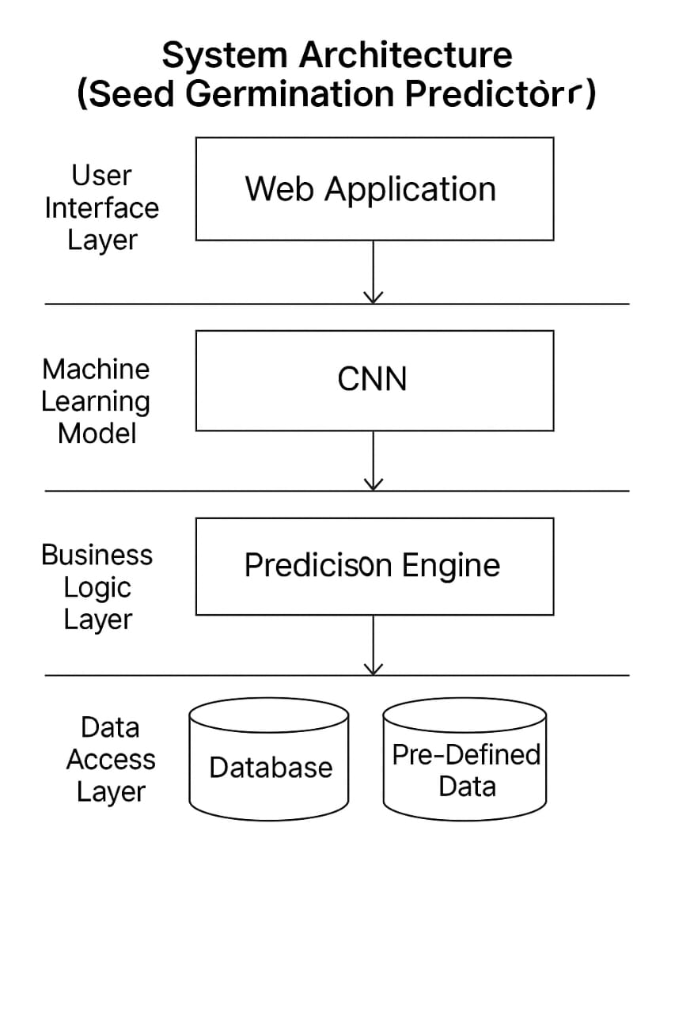
SYSTEM ARCHITECTURE
DD/MM/YYYY

Slide 9
MODULE 1 : Data Collection Module
1.Collects environmental data (temperature, growth,rainfall,soil moisture, etc.).
2.Gathers seed-related data (seed type, size, viability, dormancy status, etc.).
3.Uses sensors, databases, or manual inputs for data acquisition.
DD/MM/YYYY

Slide 10
MODULE 2 : Preprocessing and Feature Engineering Module
1.Cleans and normalizes data for consistency.
2.Extracts important features like water absorption rate, seed coat thickness, etc.
3.Handles missing values and outliers.
DD/MM/YYYY

Slide 11
MODULE 3 : Seed Quality Evaluation
1.Machine learning algorithm selection (e.g. regression, decision trees)
2.Model training and hyperparameter tuning
3.Prediction of seed quality attributes (e.g. germination rate, vigor, moisture content)
DD/MM/YYYY

Slide 12
MODULE 4 : Seed Image Analysis
1.Image processing techniques (e.g. thresholding, segmentation, feature extraction)
2.Object detection and localization (e.g. seed shape, size, orientation)
3.Image-based feature extraction (e.g. texture, color, shape)
DD/MM/YYYY

Slide 13
MODULE 5 : Model Deployment and Testing
1.Model deployment on a cloud-based platform (e.g. AWS, Google Cloud, Azure)
2.API development for model integration with external applications-
3.Testing and validation of the deployed model
DD/MM/YYYY

Slide 14

OUTPUT
DD/MM/YYYY

Slide 15
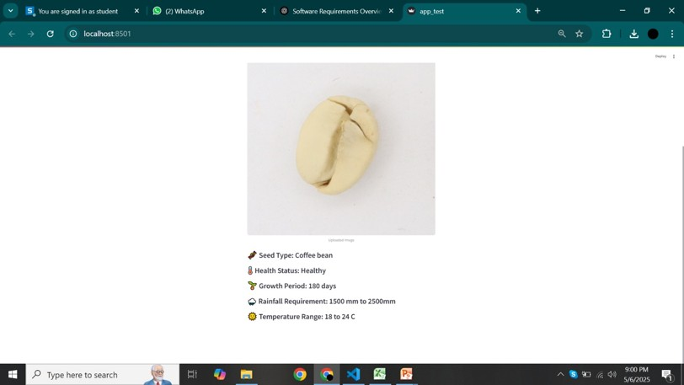
OUTPUT
DD/MM/YYYY

Slide 16
CONCLUSION & FUTURE ENHANCEMENT
Improving model accuracy:
Developing more accurate models that can predict seed germination and seedling emergence parameters, such as time to mid-germination and shoot elongation rate, using machine learning and statistical techniques.
Image-driven machine learning:
Utilizing image analysis and machine learning algorithms to predict seed germination and seedling growth, as demonstrated in recent studies on tree seed germination prediction.
DD/MM/YYYY

Slide 17
REFERENCES
1.Yuval Nehoshtan et al. (2021): "Robust Seed Germination Prediction Using Deep Learning" in Scientific Reports.
2. Baskin, C. C., & Baskin, J. M. (2014): "Seeds: Ecology, Biogeography, and Evolution of Dormancy and Germination".
3. Bewley, J. D., Bradford, K. J., Hilhorst, H. W. M., & Nonogaki, H. (2013): "Seeds: Physiology of Development, Germination and Dormancy".
DD/MM/YYYY

Slide 18

DD/MM/YYYY

